Slide 1


Seattle Police Department
Use of Force & Complaints Datasets
IMT 562 – Assignment 4
Jwala Mukhi Suresh

Slide 2
TABLEAU PUBLIC LINK
SEATTLE POLICE DASHBOARD

Slide 3
1. USE OF FORCE DATASET

Slide 4
ABOUT THE DATASET
The dataset consisted of 4 types of Use of Force incidents, their area of occurrence and subject demographics.
Link to source: https://data.seattle.gov/Public-Safety/Use-Of-Force/ppi5-g2bj
Total number of records: 13,934

Slide 5
DATA QUALITY ISSUES & TRANSFORMATION
Precinct, Sector & Beat had 747 missing or erroneous values.
Fixed the issue by combining missing and erroneous values into a group “Not specified”
3008 Subject races, 567 Subject gender were Not Specified.

Slide 6
QUESTIONS ABOUT THE DATA
What is the breakdown of subject demographics by force type?
Where is force used?
Is force trending up / down? What is the forecast?

Slide 7
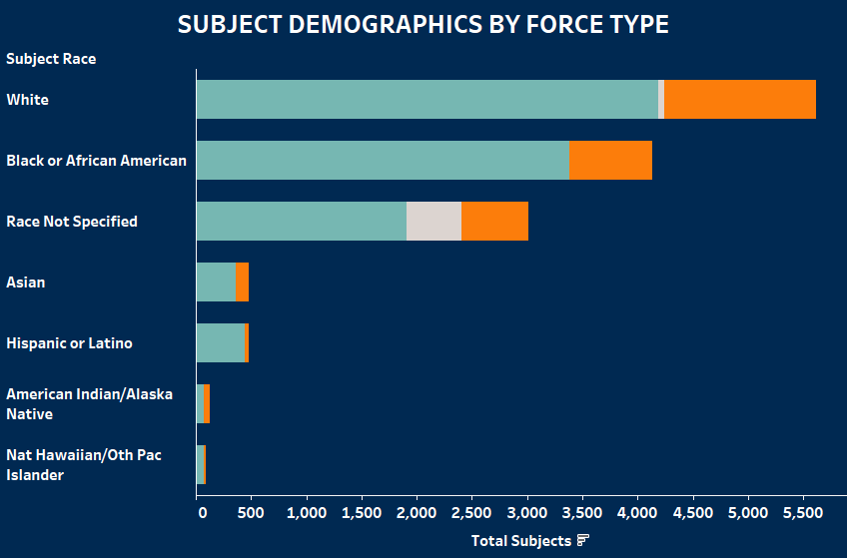
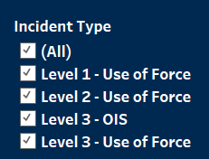
SUBJECT DEMOGRAPHICS BY FORCE TYPE
Design Decision
Filter lets user choose the incident type.
Three colors are used to represent genders
Position is used to represent subject race and total number of subjects
Insights
This visualization helps to understand which race or gender most subjects belonged to based on the incident type.
In all incident types “White Males” were the most subjects against whom force was used.

Slide 8
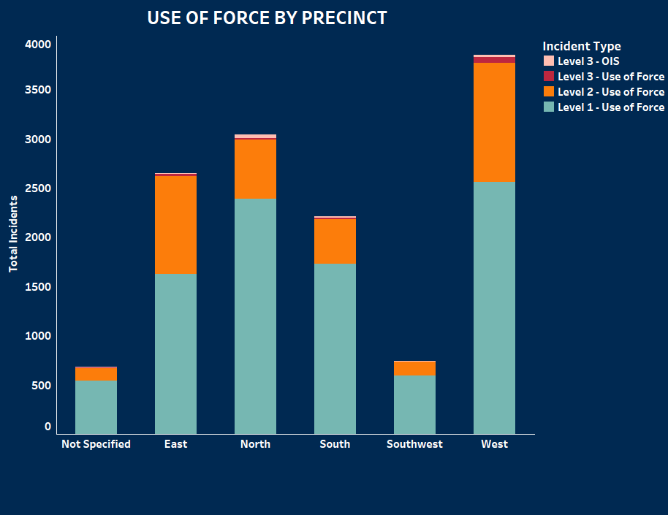

WHERE IS FORCE USED?
Design Decision
Filter lets user choose the incident type & see the force breakdown by Precinct, Sector or Beat.
Four colors are used to represent each incident type
Insights
This visualization helps to understand the area wise breakdown of force usage and which type of force was most used.
Level 1 force was the most used type and “West” Precinct had the most incidents in all force types except Level 3 – OIS which was most used in North Precinct
Interestingly U3 Beat had the highest Level 3-OIS incidents compared to E2 which had the highest Level 1 & Level 2 incidents.

Slide 9
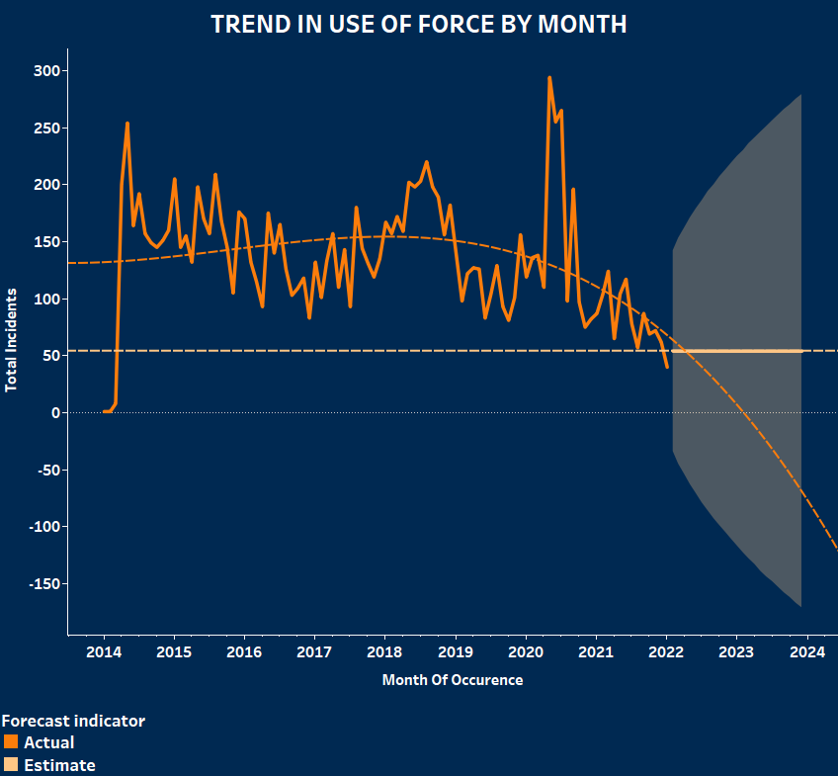
IS FORCE TRENDING UP/DOWN? WHAT IS THE FORECAST?
Insights
This visualization shows how the trend in use of force incident occurrence changed over the months.
The polynomial trend line shows that the trend of force usage is going down over the years.
R²= 0.15 & p-value =0.0016. Even though the p-value is significant the low R² value shows the model isn’t good. But the values are better than what I received for a linear trend line.
From evaluating the most recent trend in the use of force, the forecast for upcoming month (February 2022) is 54 ± 88 (Prediction Interval).

Slide 10
SUMMARY & KEY TAKEAWAYS
“White males” were the most subjects against whom force was used.
All forces were most used in West precinct except for Level 3-OIS which was most used in North precinct.
U3 Beat had the highest Level 3-OIS incidents compared to E2 which had the highest Level 1 & Level 2 incidents.
The trend of force usage is going down. The forecast for upcoming month (February 2022) is 54 ± 88 (Prediction Interval).
There were 747 missing or erroneous values in Precinct, Sector & Beat which was close to 5% of total records.

Slide 11
2. COMPLAINTS DATASET

Slide 12
ABOUT THE DATASET
The dataset consisted of 46 different allegations, complainant details and details of named employee against which the allegations were filed.
Link to source: https://data.seattle.gov/Public-Safety/Office-of-Police-Accountability-Complaints/99yi-dthu
Total number of records : 42,377
Total number of records after removing duplicates: 26641

Slide 13
DATA QUALITY ISSUES & TRANSFORMATION
15736 duplicate records.
15640 missing or erroneous values in Precinct, Sector & Beat.
For 4154 incidents, allegations were not specified.
There were many missing and unknown values in Complainant age, gender and race columns.
Fixed the issue by combining missing and unknown values into a Not specified group.
Complainant age values were grouped into 5 age groups.
0-4 : Babies , 5-16 : Children, 17-30 : Young Adults, 31-45 : Middle-aged Adults, 46 & above : Old Adults
Sources that received comparatively low complaints were grouped into “Other Sources” bucket
The records before 2014 were removed as the number of incidents reported appeared incomplete.

Slide 14
QUESTIONS ABOUT THE DATA
Who is receiving complaints?
What are the complaints for?
Who is complaining?
Are complaints trending up / down? What is the forecast for complaints?

Slide 15
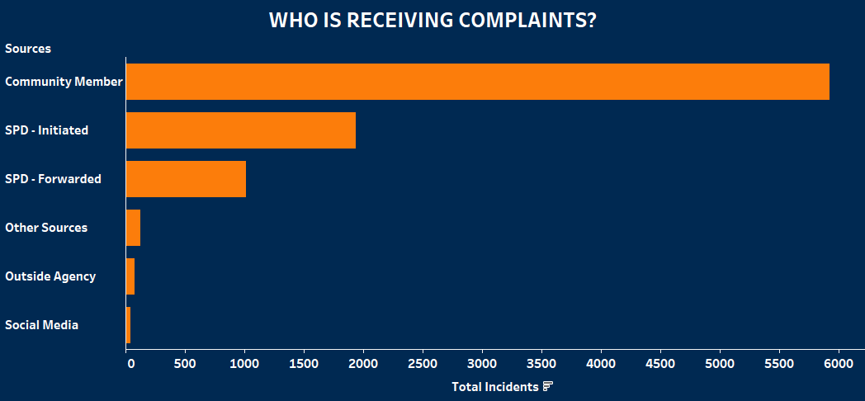
WHO IS RECEIVING COMPLAINTS?
Design Decision
Position is used to represent the sources receiving complaints and the total incidents reported.
Sources that had comparatively very low incidents reported to them were grouped into an “Other sources” bucket. The tooltip includes each source along with the total incidents received by them.
Insights
65% of incidents were reported to Community Member (5926).

Slide 16
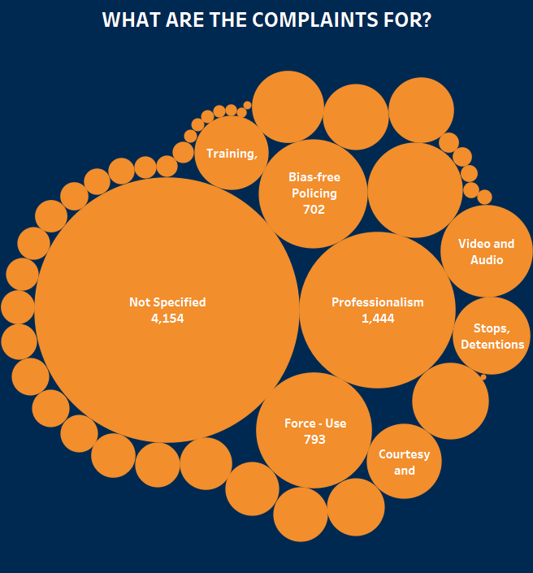
WHAT ARE THE COMPLAINTS FOR?
Design Decision
The 46 allegations are shown as bubbles with size representing total number of incidents reported in each.
Insights
Allegation type was not specified for 4154 incidents.
Professionalism was the most reported allegation with a total of 1444 incidents followed by Force-use with 793,and Bias-free policing with 702 incidents.

Slide 17
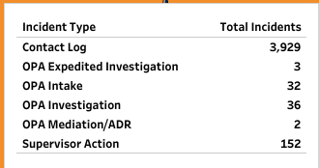
WHAT ARE THE COMPLAINTS FOR?
Improvements to the visualization
Based on the suggestion I received during the presentation, I tried to deep dive into the data to understand which incident types had the greatest number of missing allegations. I found that “Contact Log” had the most missing allegation (3929). Included the details in the tool tip for better understanding. Now the user will be able to understand the incident types even though the allegations are missing. Also, to gain a better understanding why there were so many missing allegations, I looked at the SPD website and found that “Contact Log” includes incidents that are not considered as policy violations, or those that have insufficient information to proceed with the inquiry. I think it’s because of this, we are seeing many missing values in allegations. Other allegations had only a little to no incidents reported as Contact Log incident type.

Slide 18
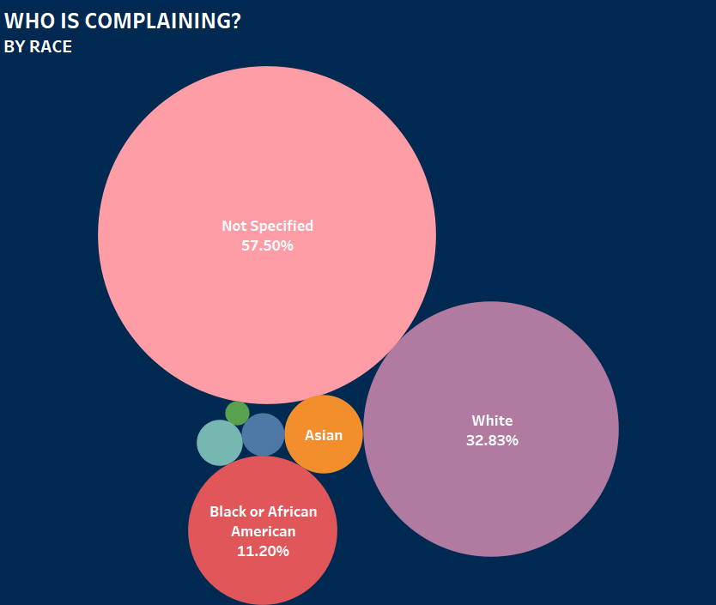

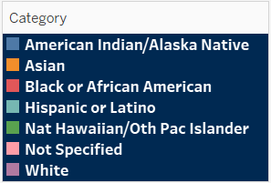
WHO IS COMPLAINING?
Design Decision
View by complainant filter lets user choose whether they want to see complainants by age, race or gender.
The bubble chart shows the selected demography with size representing total incidents and color representing the categories in each demography.
Insights
57.50% of total incidents didn’t have complainant race,62.63% of total incidents didn’t have complainant age and 34.06% of total incidents didn’t have complainant gender.
Most complaints were White(32.83%) by race.
Most complaints were Male(45.63%) by gender.
Most complaints were Old Adults(46 & above )(18.99%) by age.

Slide 19
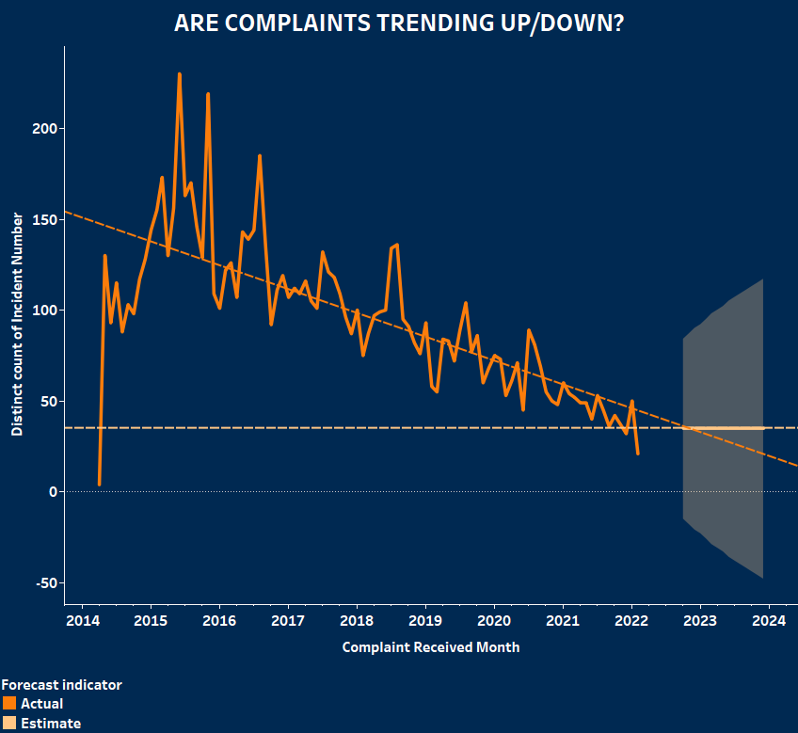
ARE COMPLAINTS TRENDING UP / DOWN?
Insights
This visualization shows how the trend of complaints received changed over the months.
The linear trend line shows that the number of complaints are going down over the years.
R²= 0.53 & p-value <0.0001 which shows that the model is a good fit
From evaluating the most recent trend in complaints , the forecast for upcoming month (October 2022) is 35 ± 49 (Prediction Interval).

Slide 20
SUMMARY & KEY TAKEAWAYS
There were multiple data issues including 15736 duplicate records and 59% values were missing for Precinct, Sector & Beat.
65% of complaints were reported to Community member.
Professionalism was the most reported allegation with a total of 1444 incidents followed by Force-use with 793,and Bias-free policing with 702 incidents.
Most complaints were White(32.83%) by race.
Most complaints were Male(45.63%) by gender.
Most complaints were Old Adults(46 & above )(18.99%) by age.
The trend of complaints are going down. The forecast for upcoming month (October 2022) is 35 ± 49 (Prediction Interval).

